Slide 1




My Folder, My Work
Learn to download a file and save it in YOUR own folder

Slide 2
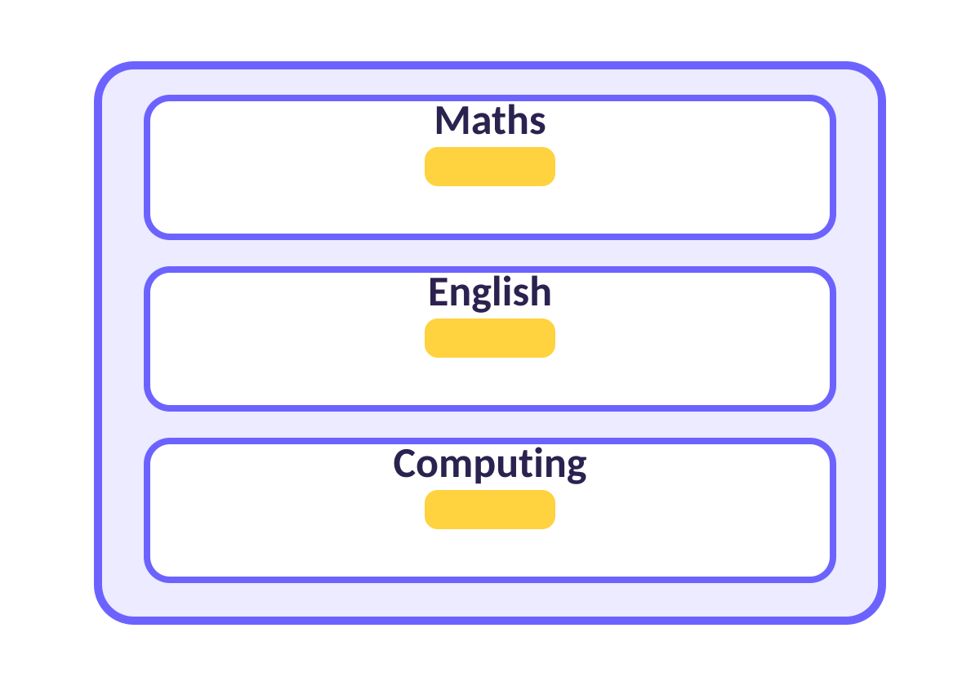
Why do we need folders?
FOLDERS
Folders are drawers in a cupboard
Maths drawer: all my maths.
Computing drawer: all my computing.
Your folder: only YOUR work, so it is easy to find!
Notes:
Teacher: ask who has lost a file before. Folders stop that.

Slide 3
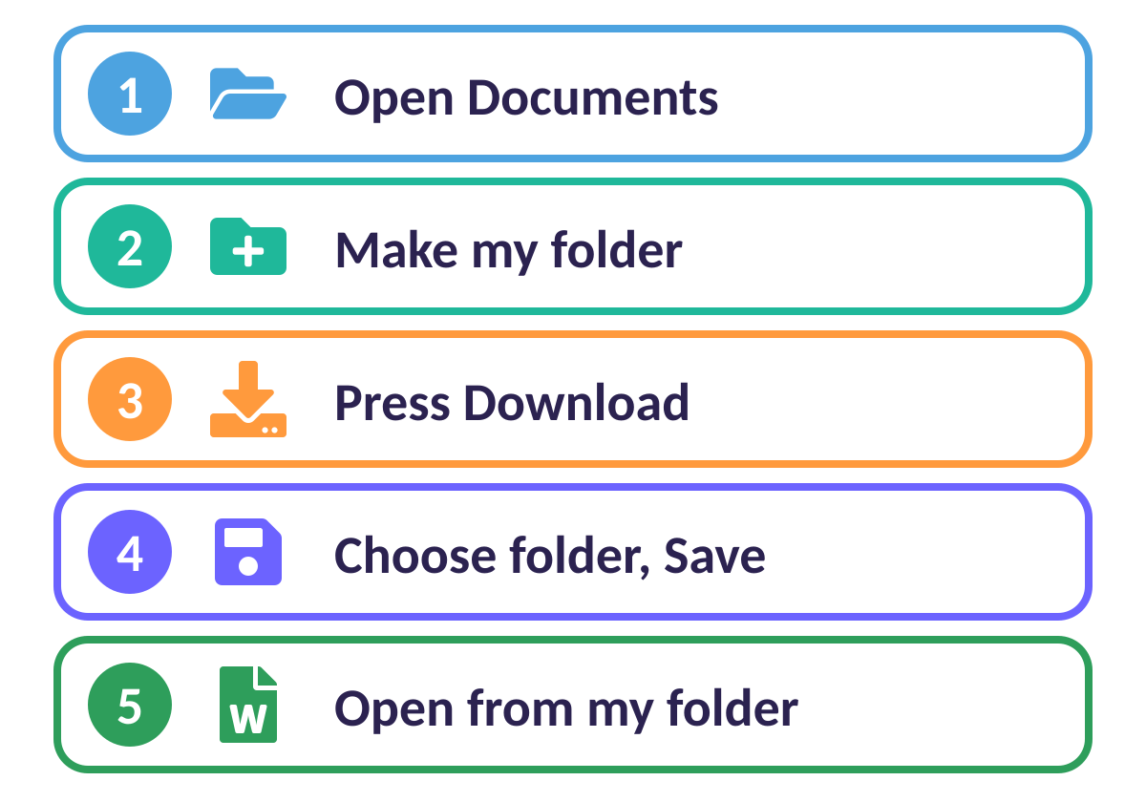
5 easy steps
THE PLAN
Follow the numbers, one at a time
1 Open Documents.
2 Make your folder.
3 Press Download.
4 Choose your folder and Save.
5 Open it from your folder.
Notes:
Display this plan on the board all lesson. Tick each step together.

Slide 4
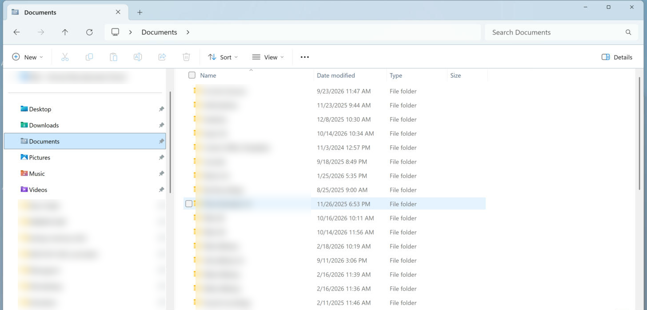
Step 1: Open Documents
1
1 Click Documents on the left. Your own folders will be inside.

Slide 5
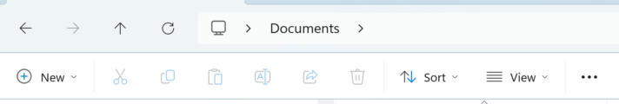
Step 2: Make your folder
1
1 Click New (top left).
2 Click Folder.
3 Type Y3-Ali (class + your name), press Enter.

Slide 6
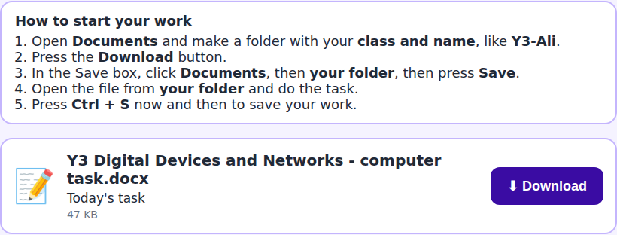
Step 3: Press Download
1
1 Press the Download button next to your file.

Slide 7
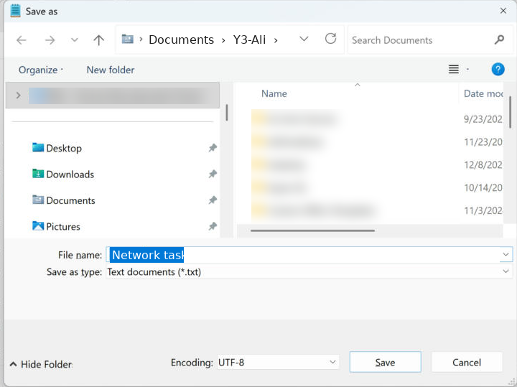
Step 4: Save in YOUR folder
1
1 Check the top says Documents › your folder.
2 Check the file name.
3 Press Save!
2
3

Slide 8
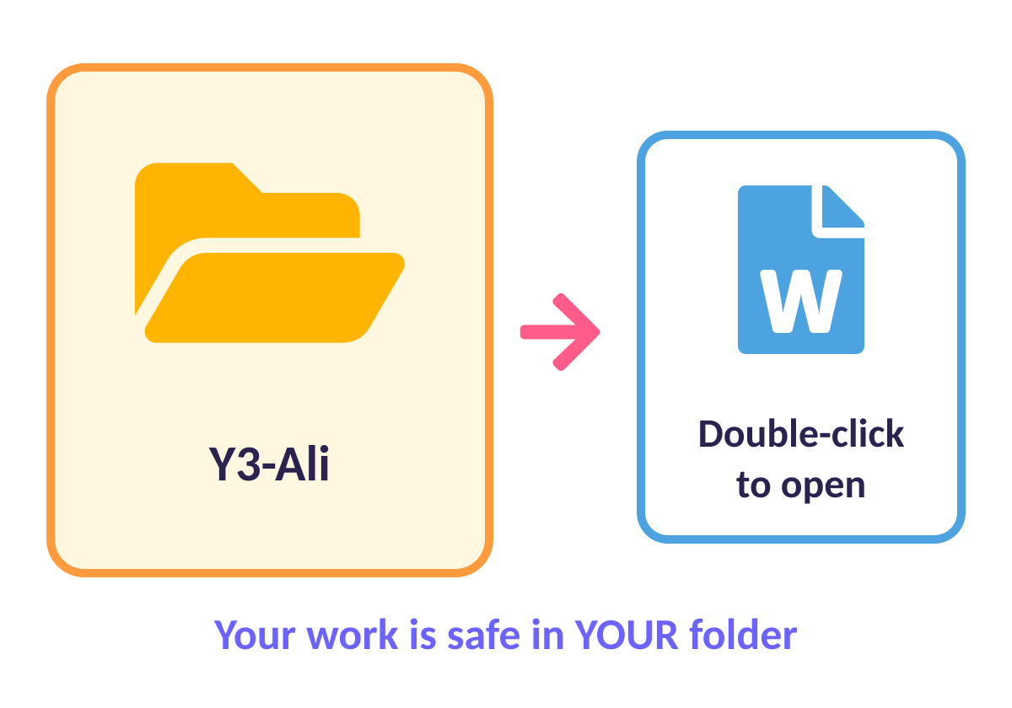
Step 5: Find it again
OPEN IT
Open your folder, double-click your file
Open: Documents, then your folder.
Double-click: the file to open it.
Work: then save again with Ctrl + S.
Notes:
Ctrl + S saves. Pupils press it every few minutes.

Slide 9
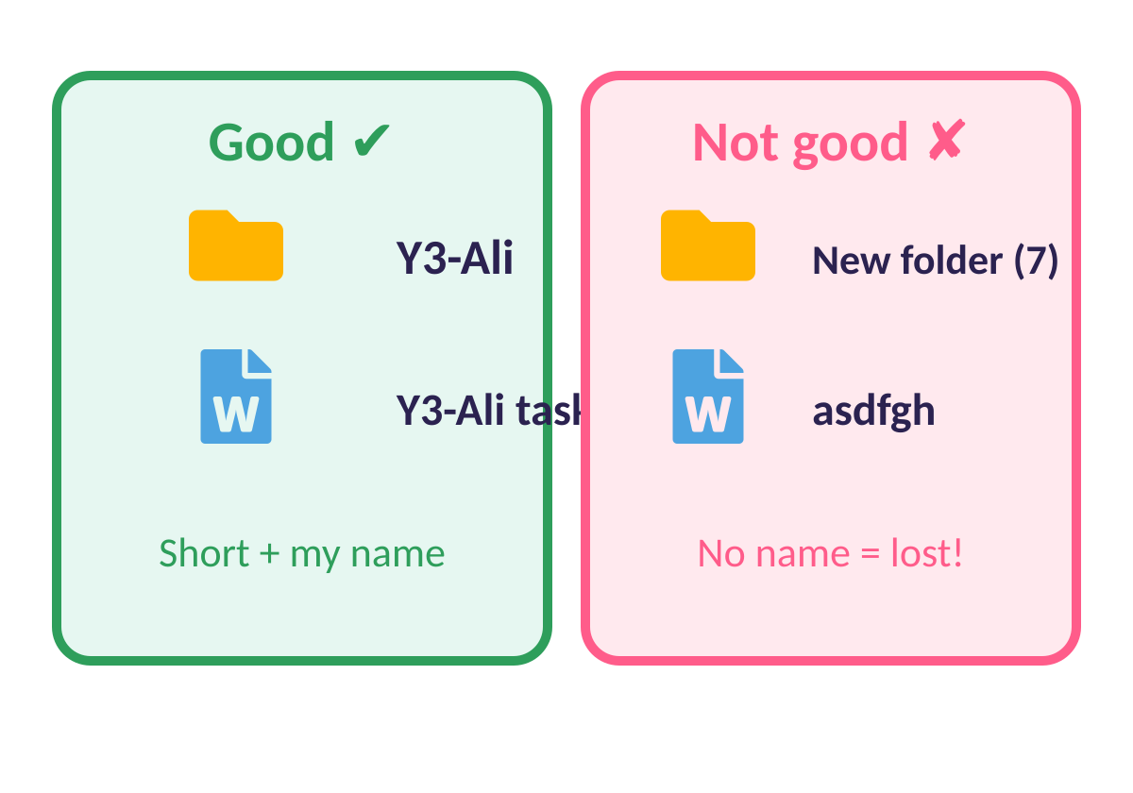
Good names help
NAMES
A good name is short and has MY name
Folder: class + name, like Y3-Ali.
File: add your name to the end.
Avoid: New folder (7) or random letters.

Slide 10
Quick quiz
Where do we save our work?
On the desktop, anywhere
A
In MY folder inside Documents
B
In someone else’s folder
C
Notes:
Pupils vote with fingers (1, 2, 3) or on mini whiteboards before the answer slide.

Slide 11
✔ The answer
Where do we save our work?
On the desktop, anywhere
A
In MY folder inside Documents
B
In someone else’s folder
C
In my own folder, in Documents.
Notes:
Pupils vote with fingers (1, 2, 3) or on mini whiteboards before the answer slide.

Slide 12
Quick quiz
Which button do we press to get the file from the Work Area?
Save
A
Download
B
Delete
C
Notes:
Pupils vote with fingers (1, 2, 3) or on mini whiteboards before the answer slide.

Slide 13
✔ The answer
Which button do we press to get the file from the Work Area?
Save
A
Download
B
Delete
C
Download starts the Save As box.
Notes:
Pupils vote with fingers (1, 2, 3) or on mini whiteboards before the answer slide.

Slide 14
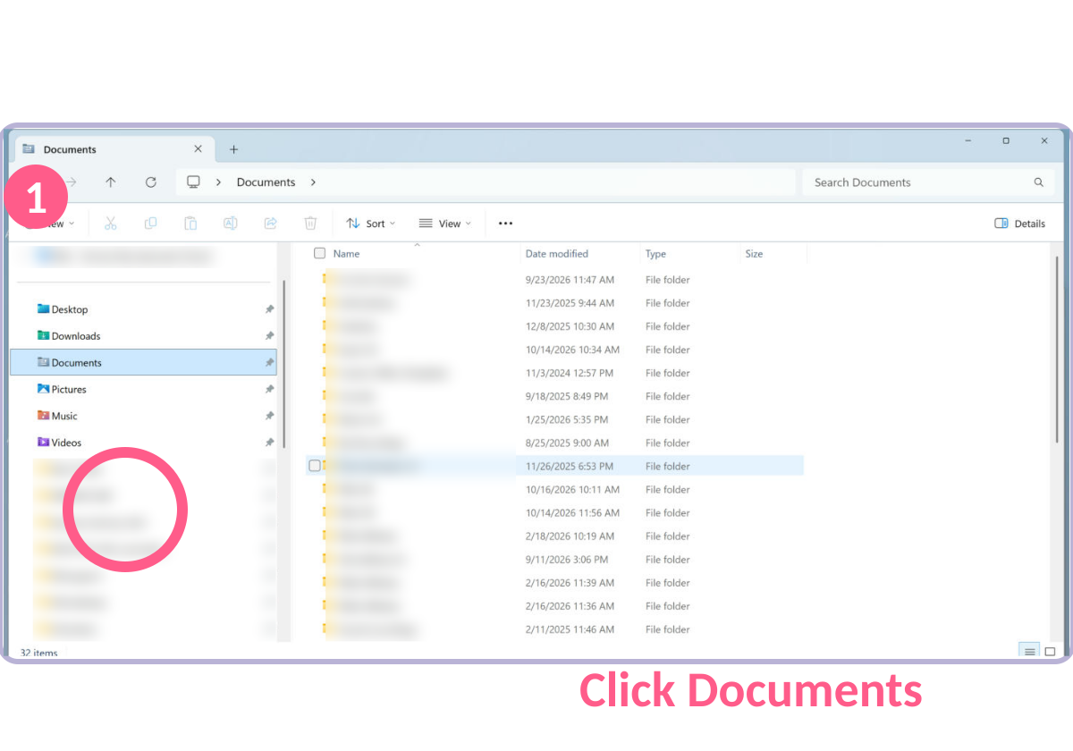
Activity: Do it yourself!
ACTIVITY
Open Documents.
1
Make a folder with your class and name.
2
Download today’s task from the Work Area.
3
Save it in YOUR folder, then open it.
4
Notes:
Walk around. Pupils who finish help a neighbour (not touch their mouse!).

Slide 15
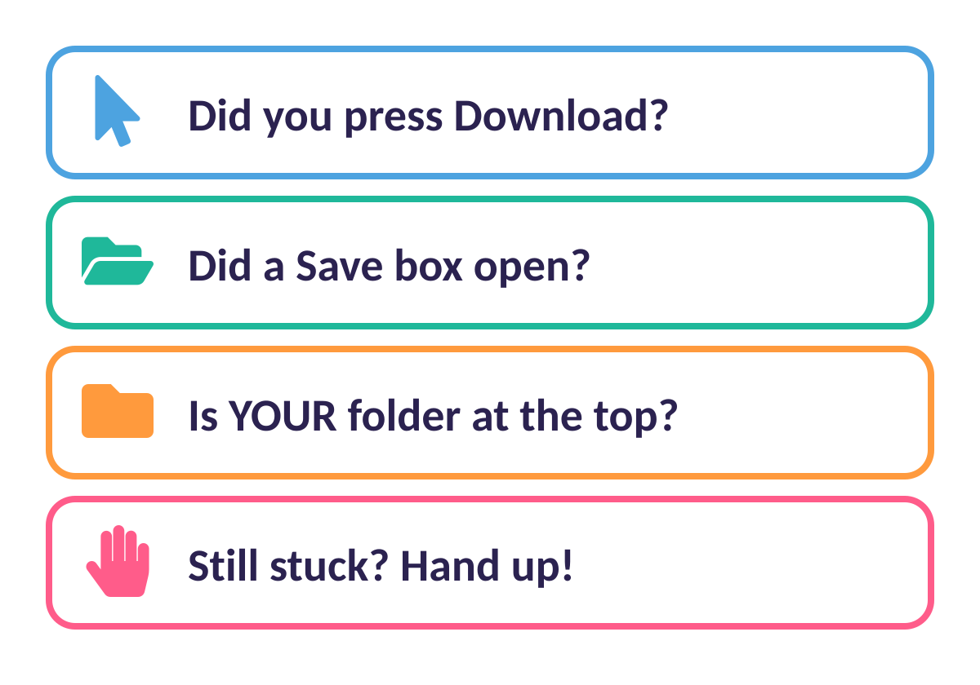
Stuck? Check this list
HELP CARD
Read it before you put your hand up
Tip: read each question slowly.
Still stuck? Ask a friend, then your teacher.

Slide 16




Brilliant work!
You are now experts. Keep asking questions!

